Slide 1

SQL Injection
By- Hyperion

Slide 2

What is a SQL Injection?
Attacker uses SQL commands to breach a website’s security.
Hackers typically attack applications to retrieve data or personal information.
One of the most common injection attacks.
Notes:
SQL injection are one of the easiest hacks to pull off requiring only entry level skills to do.
While it may not be complicated to pull off that doesn't make it any less dangerous, it allows for the hacker to add their own code to your website/database/directory which is very dangerous.
Double dash at the end turns the remaining code in the line into a comment so it doesn't execute

Slide 3
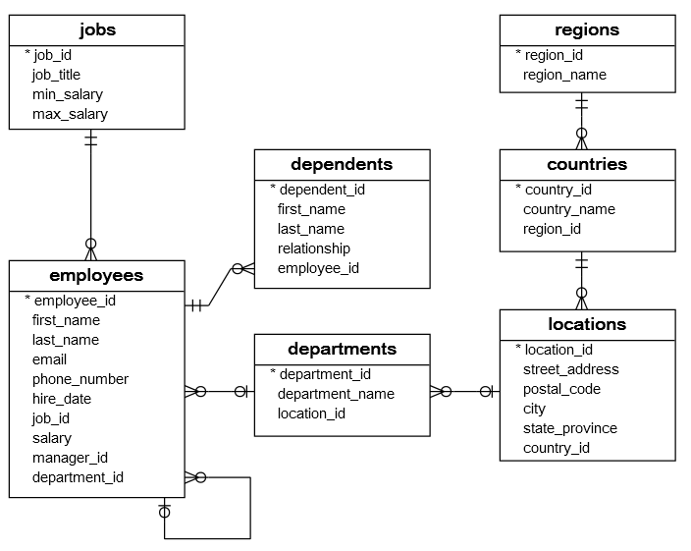
Impact On Businesses
Businesses store data in some kind of database on their websites.
Companies like ESPN, YouTube, and Facebook use databases.
SQL injections can compromise these databases.
Notes:
The image is a list of databases that could be on a server
SQL injections can have many potentially devastating consequences.
It can lead to a loss of trust and reputation especially considering how easy it is to pull off
It allows for privilege escalation, unfettered access to the databases, and the ability to execute any code you want.

Slide 4
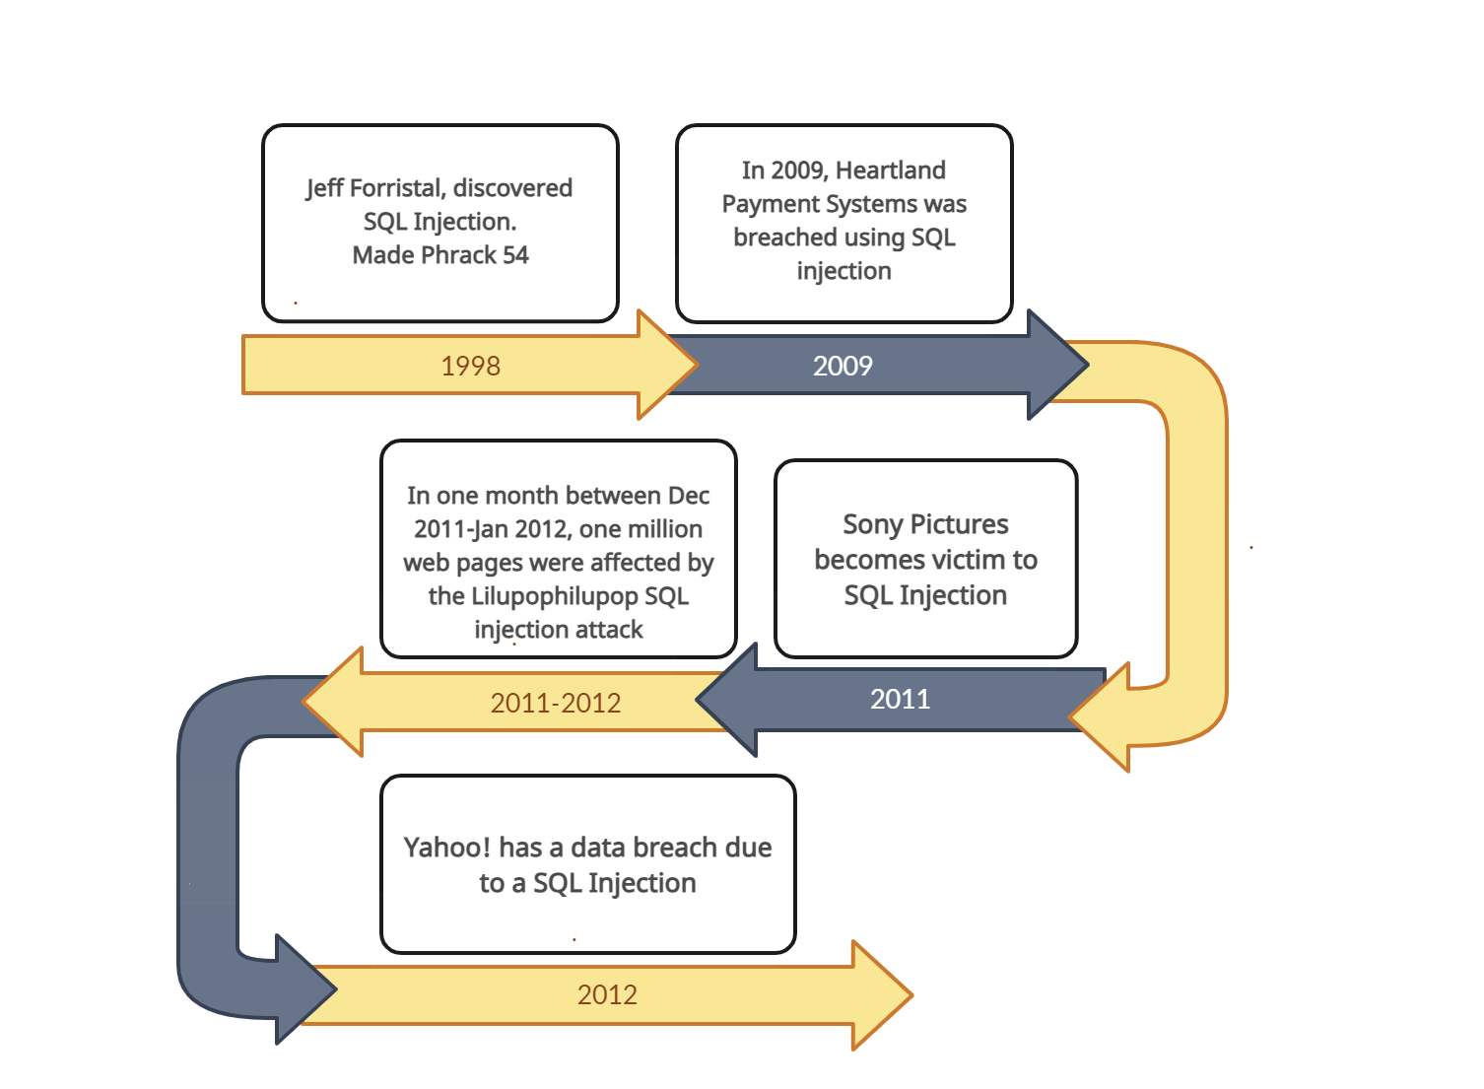
Brief History of SQL Attacks
2016

Slide 5
Live Demonstration

Slide 6
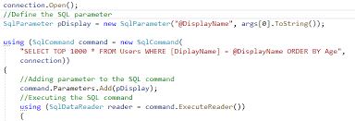
Threat Mitigation Recommendations
Implementing Parameterized Statements
Implementing Least Privilege Principles
Securing Passwords
Using Third Party Authentication Services
Sanitizing Inputs

Slide 7
Team Reflection
We’ve learned to sanitize the inputs to SQL databases.
We’ve learned that this is a widespread risk.
We feel astonished that this is still such a common issue.

